Slide 1
HEALTHCARE AND TELEMEDICINE
Initial App Name: Worth Care

Slide 2
Table of
Contents
Introduction
Short description of the project.
Background
Discussion about existing system and difference between ours.
Objectives
Key Features with details
Required Softwares
Softwares those will be used to make this including programming languages.
Budget (If we spent)
Software making costs and estimated budget.
Possibilities and Issues
Future improvements and possibilities.

Slide 3
Introduction
Short description of the project.
WorthCare
This app will work like a health and fitness tool that has multiple functionality. Basically it will follow the BMI of the users and keep them updated daily what they need to do to improve their health condition. Moreover, it will have a medicine directory that will help users to know about the details about a medicine. There will be a medicine reminder, users have to set the medicine names and the timing when they take those, our app will notify about that.

Slide 4


Have a look at our features!

Slide 5
Objectives
Key Features
BMI Calculation
Medicine Directory
Medication Reminder
After installing the app, it will ask to insert height and weight to calculate BMI and will send push notifications to improve health on daily basis.
This directory will tell users details about the corresponding medicines and it’s reactions, usage time schedule(avg) etc.
User have to put the medicine names and when he/she takes that. App will send a reminder on that time, useful for Senior citizen.
Consultation (ChatBot)
Following BMI
App will ask the user daily on a particular time that how he/she is feeling? There will be checkbox options to tell the app about health status and it will suggest some tips.
Based on the BMI, app will set a goal tracker in the dashboard according to standard food diet.

Slide 6
Our Vision
The Difference Between The Existing System And Ours
There can be some fitness tracking category applications. Our application will have those features as well, additionally it will communicate with it’s users and will help to maintain his/her health properly based on the standard health status. And later on, there are some upcoming features those will be “All in One”

Slide 7
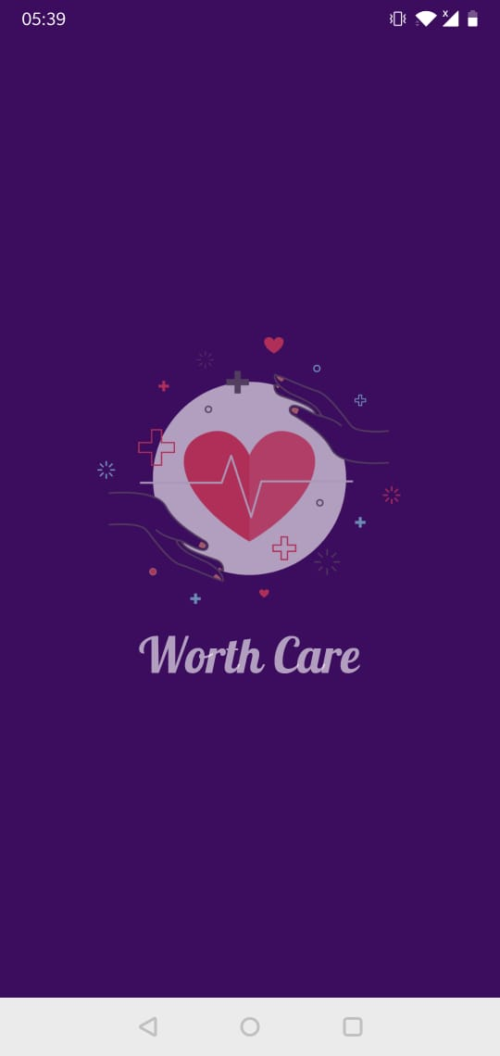

Slide 8
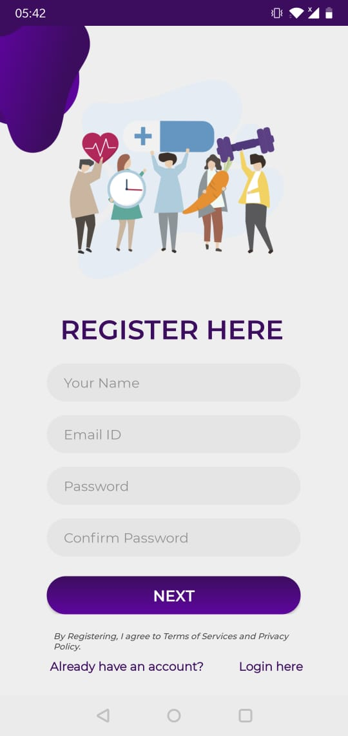

Slide 9
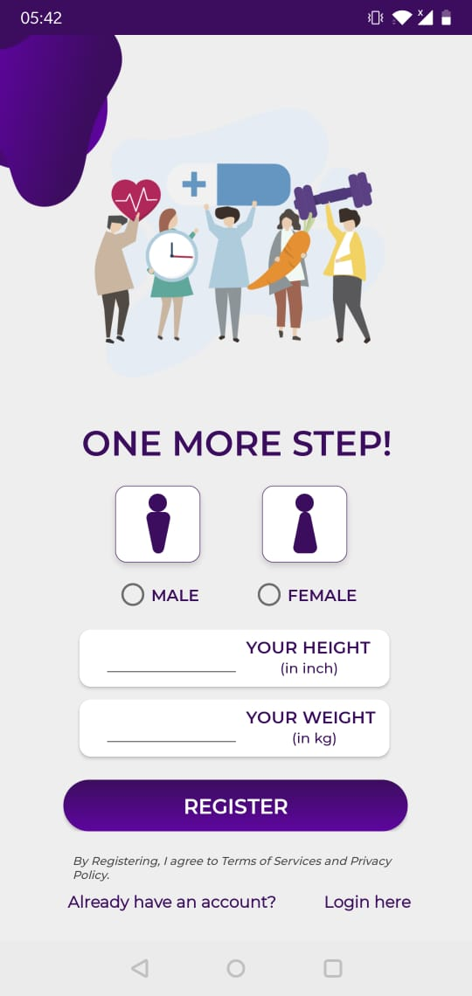

Slide 10
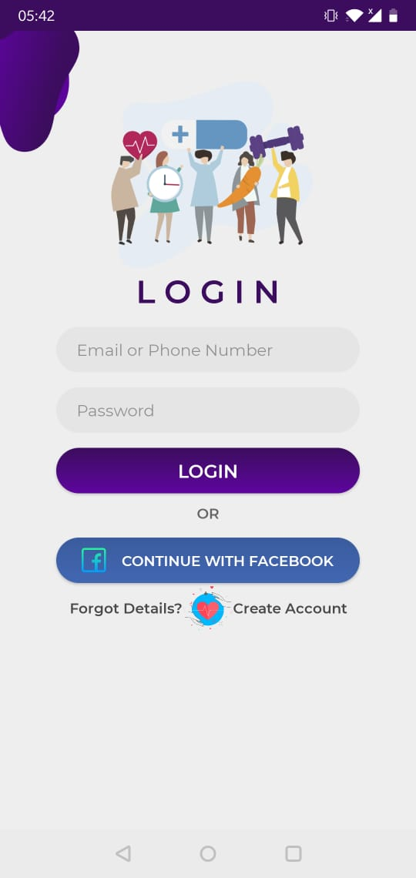

Slide 11
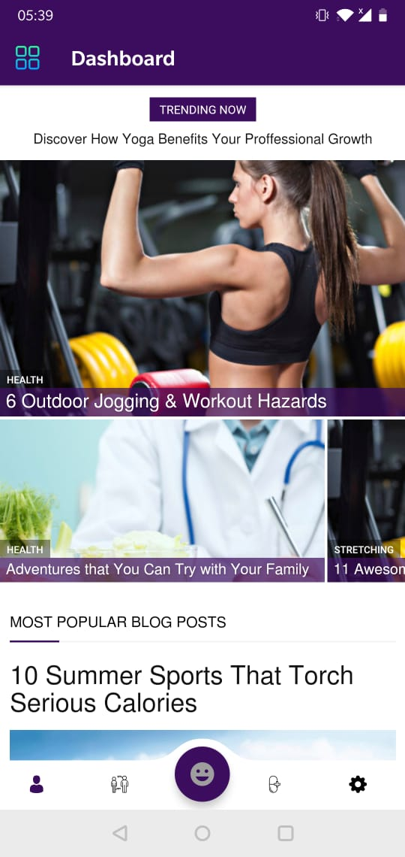

Slide 13
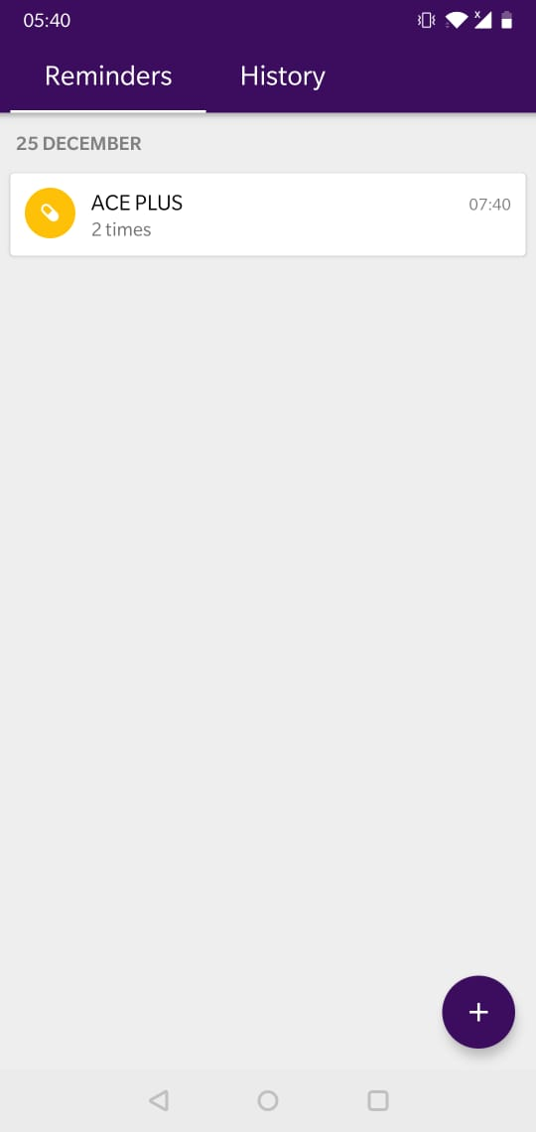

Slide 14
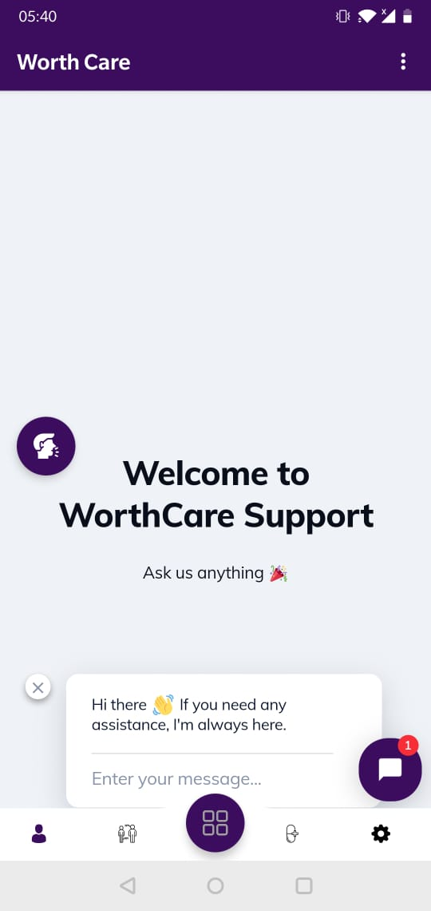

Slide 15
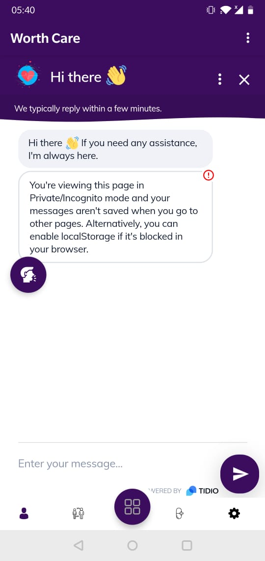

Slide 16
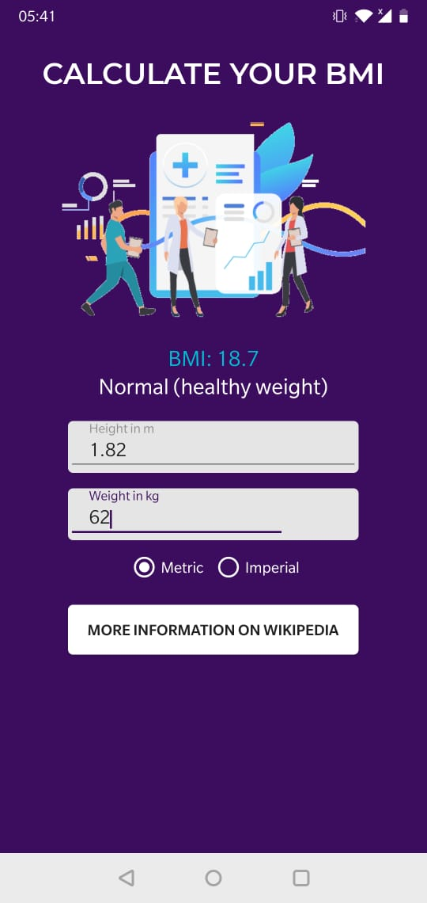

Slide 17
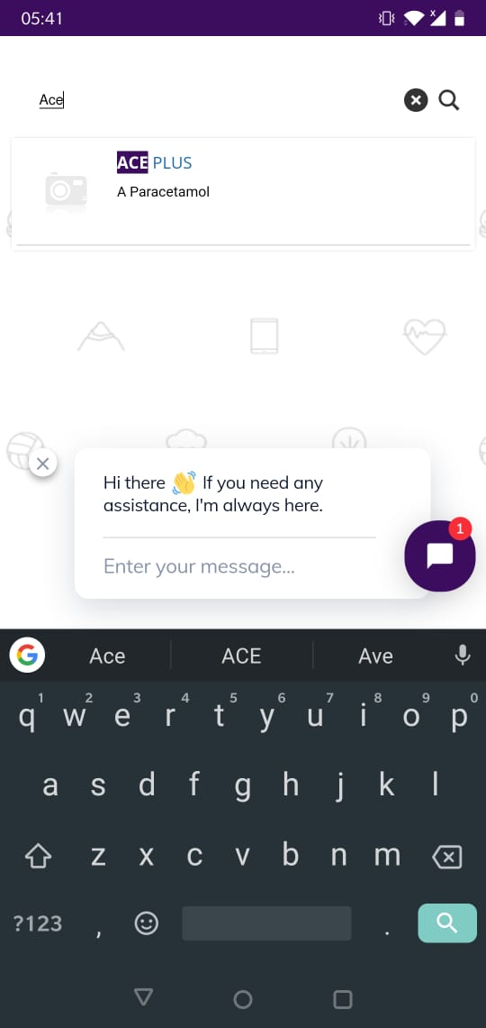

Slide 18
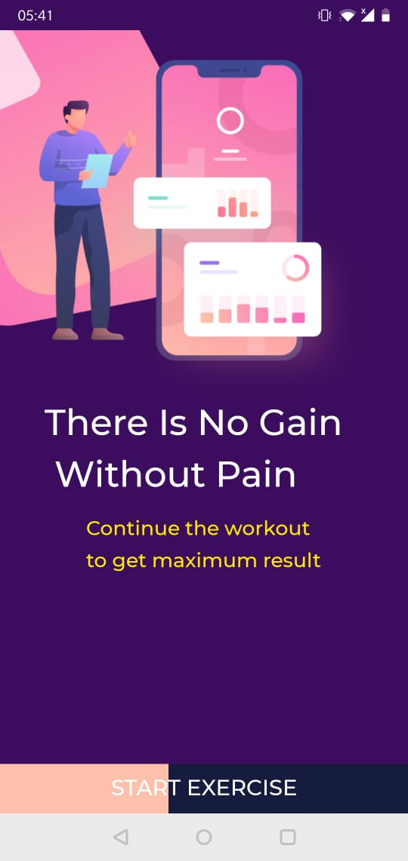

Slide 19
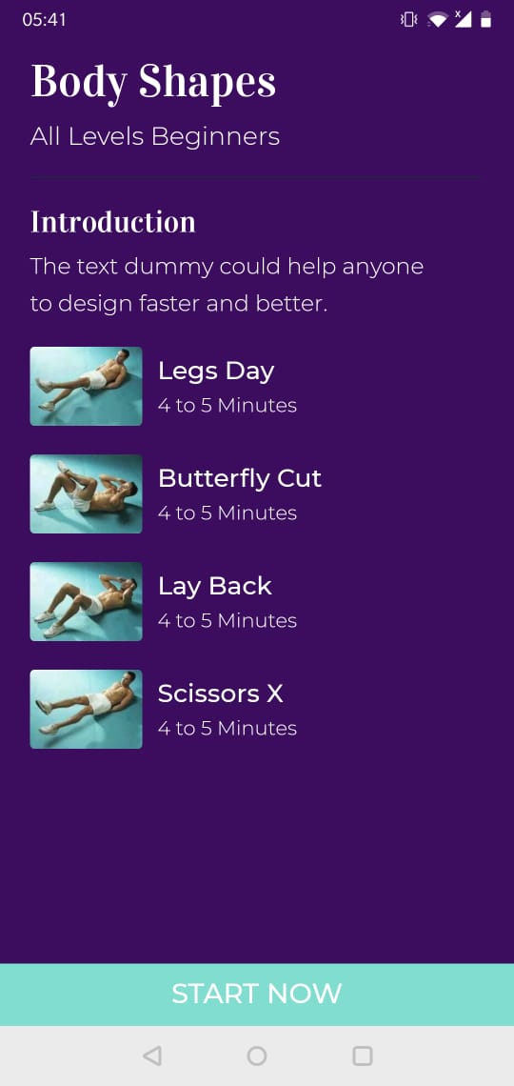

Slide 20
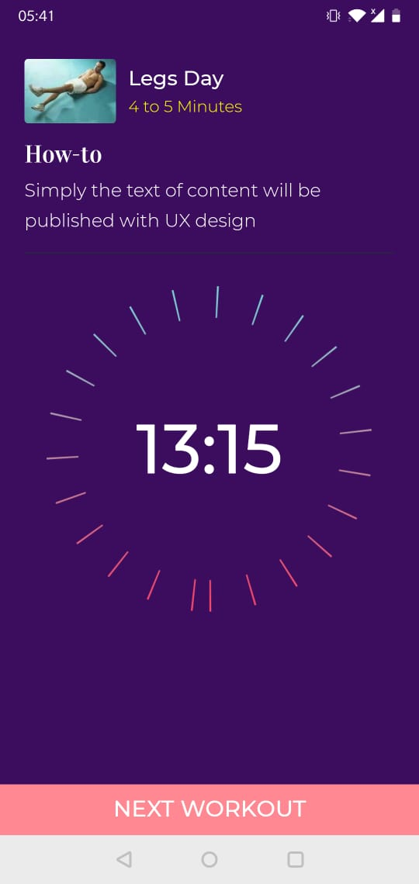

Slide 21
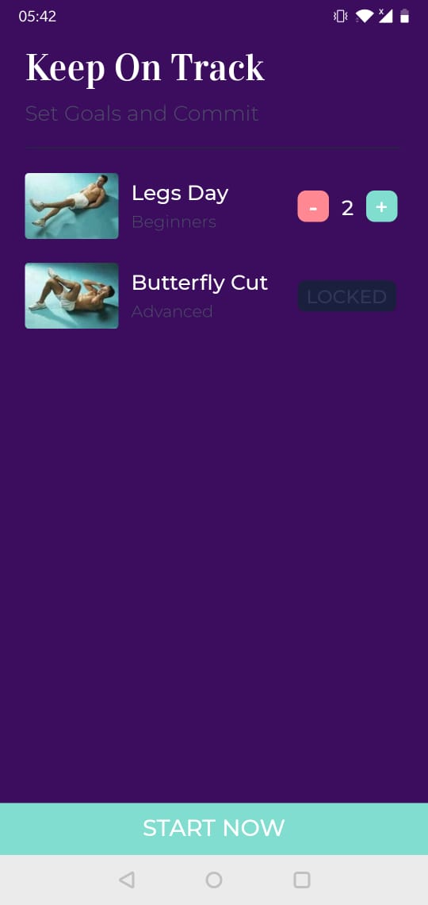

Slide 22
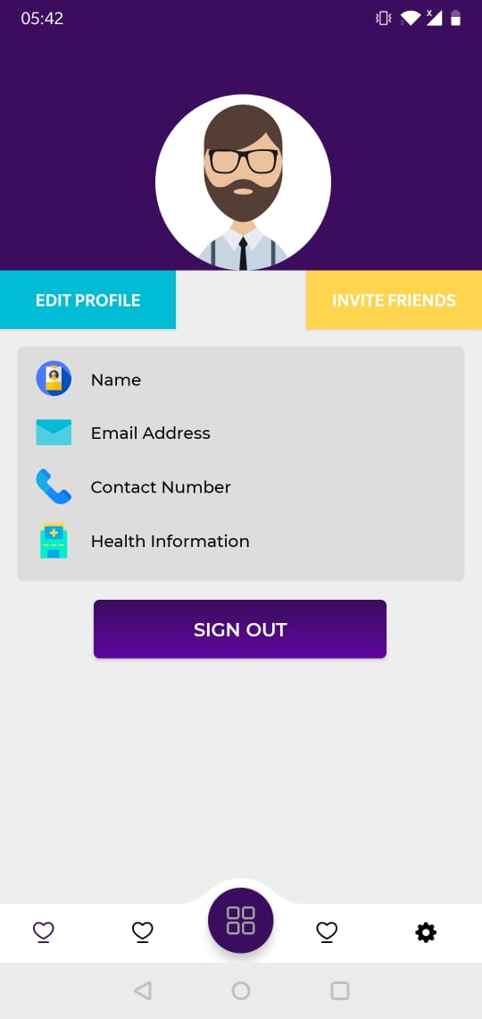

Slide 23
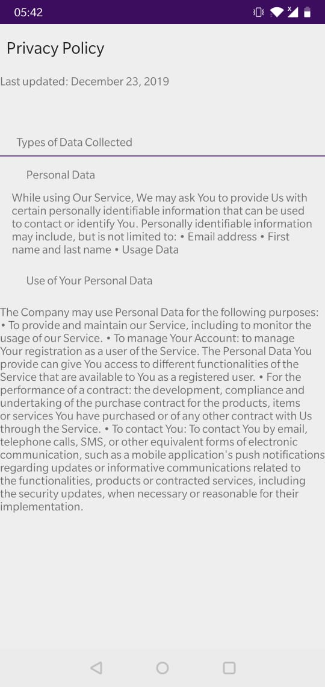

Slide 24
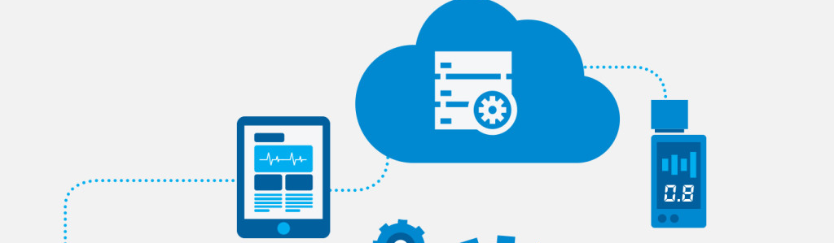



Required Softwares
Adobe XD
Visual Studio Code
Android Studio
For User Interface Designing
We will use this for php and server environment setup.
For the main app development. We will use java, java scripts, php, MySQL.

Slide 25
Budget and Estimated Costs
Have we spent some money?
API
For User Authentication we have used Firebase and for Realtime database as well.
WEB 2 API
For our automated push notification systems, that feature is relatable to chatbots. Based on the testing purpose and it’s publications, we might have to purchase an API.
A little cost! It’s time to give effort.
As we have used external chatbots and that is on our own website, so for domain we spent some bucks.

Slide 26
Development Process
Tasks List
5 steps
Generate the approximate tasks list on Trello board and keep that updated as well as GitHub repository.
APP UI
According to the tasks list, finding out the required App UI screens and design them
Databases, API and Drawable Resources
From the tasks list, approximately required database tables, and primary APIs should be ready.
Development
Work on android studio to make and develop the app and connect that to the database
Deployment
Using Database and APIs, the app should be run on devices or emulators.

Slide 27
Future Possibilities
5 keywords
Doctor’s appointment
Consultation on the App.
Satisfaction
Health Forum
Proper Diet
Suggest More!

Slide 28
Thank You for Watching!
Any Questions?

